Slide 1
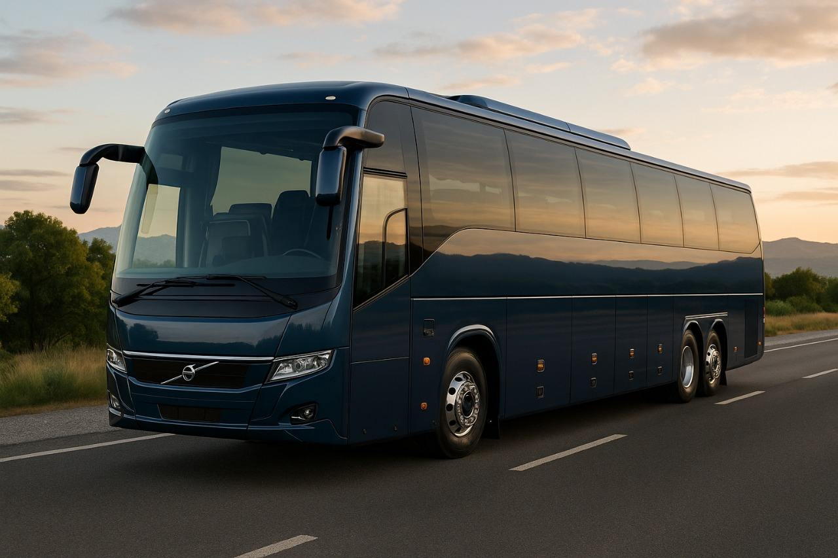

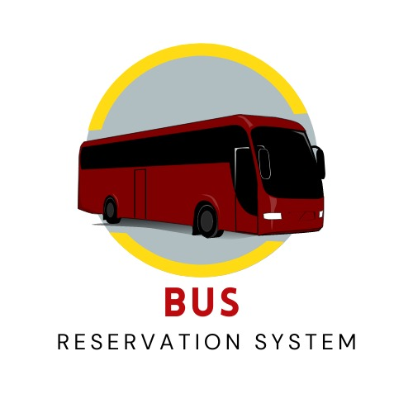
BusBuddie
The BusBuddie makes booking tickets simple and quick. People can easily find bus routes and timings that suit them. They can choose their preferred seats and make payments safely. Changing or cancelling tickets is also hassle-free. It helps save time, avoids long queues, and makes travel more comfortable and convenient for everyone. Passengers can plan their trips better. Overall, it improves the travel experience for all.

Slide 2


Team Members :
Harshal Bhamre
Pramod Kadnar
Devesh Nehete
Roll No: 05
Roll No: 25
Roll No: 39
Enrollment No: 23610230115
Enrollment No: 23610230136
Enrollment No :23610230153
Work :Database, Hosting and PPT
Work: Founder & Lead Developer
Work : Frontend Designer

Slide 3


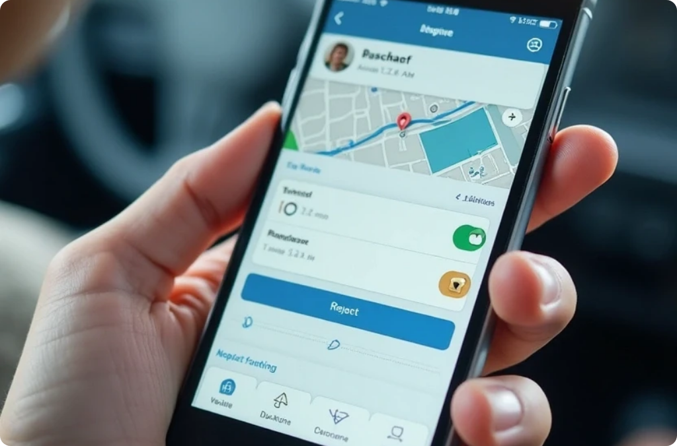
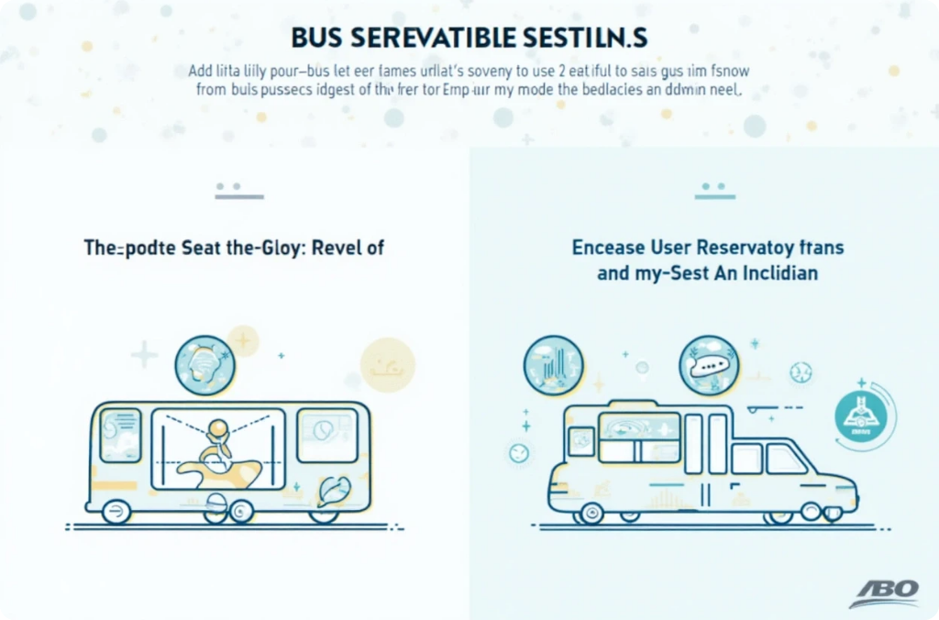
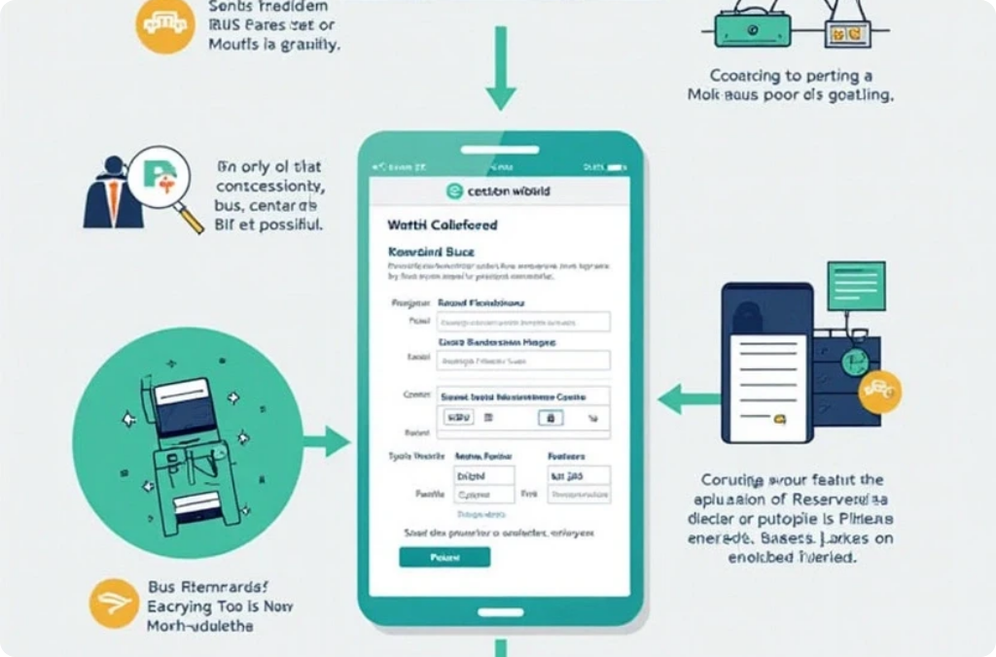
BusBuddie Overview
Project Overview
Importance
System Features
Enhances efficiency and convenience in travel
Real-time availability and easy booking process

Slide 4





System Requirements
User-friendly interface
1
Secure payment gateway
2
4
Database management system
Real-time booking updates
3

Slide 5
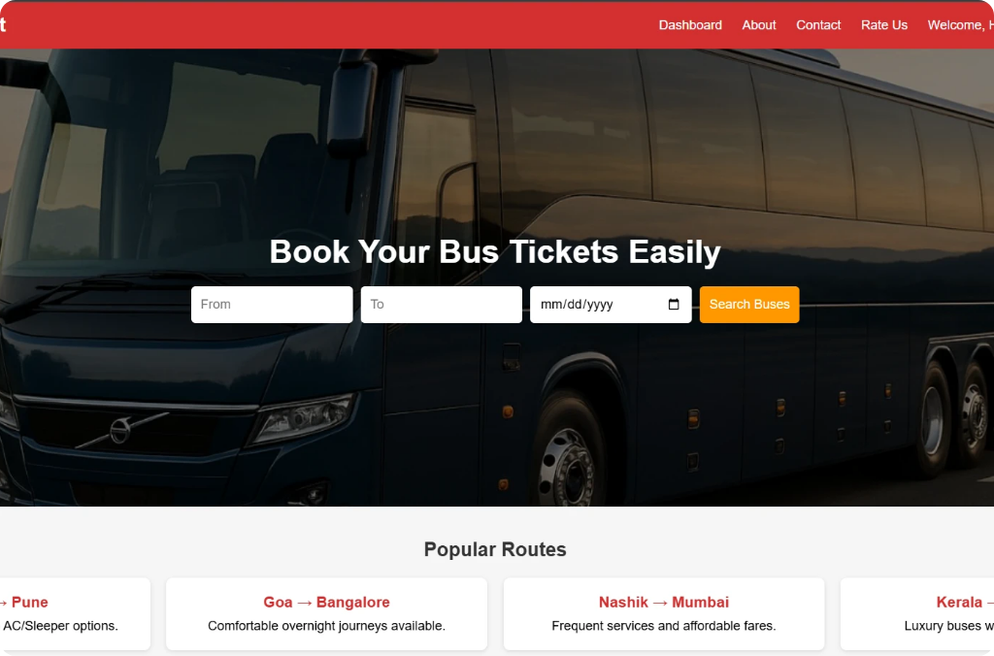
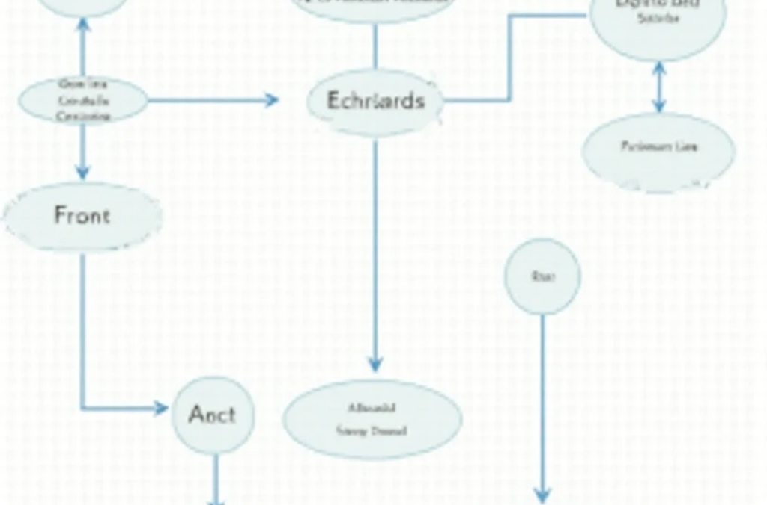
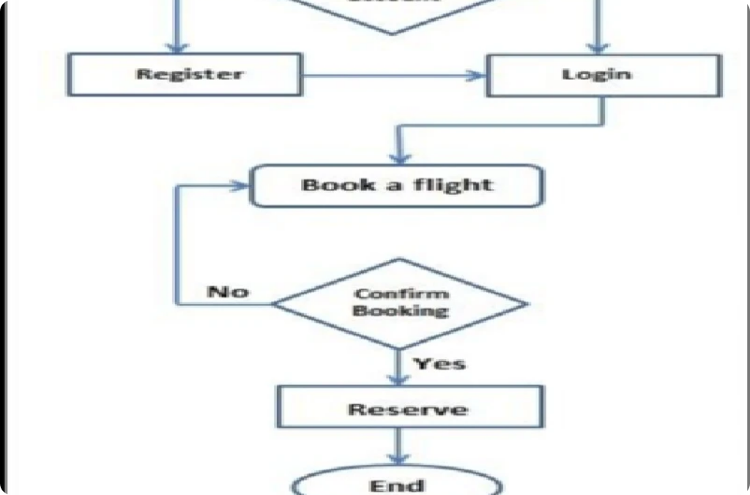
Project Design Overview
User Interface
Database schema overview
Flow chart

Slide 6



Technology Stack Overview
1
Programming Languages
2
Frameworks and Libraries
3
Database Technology
PHP – Handles the back-end work like booking and connecting to the database.
HTML,CSS ,JS ,PHP
MYSQL Server
MySQL – Helps to store and get booking details from the database.

Slide 7


Application Integration
Successful application implementation involves seamless integration with various systems, including payment gateways and user interfaces. By effectively coding the application and testing its functionality, we ensure a smooth user experience. This foundational work supports the subsequent steps in the bus buddie process, where user interactions and bookings take place efficiently.

Slide 8

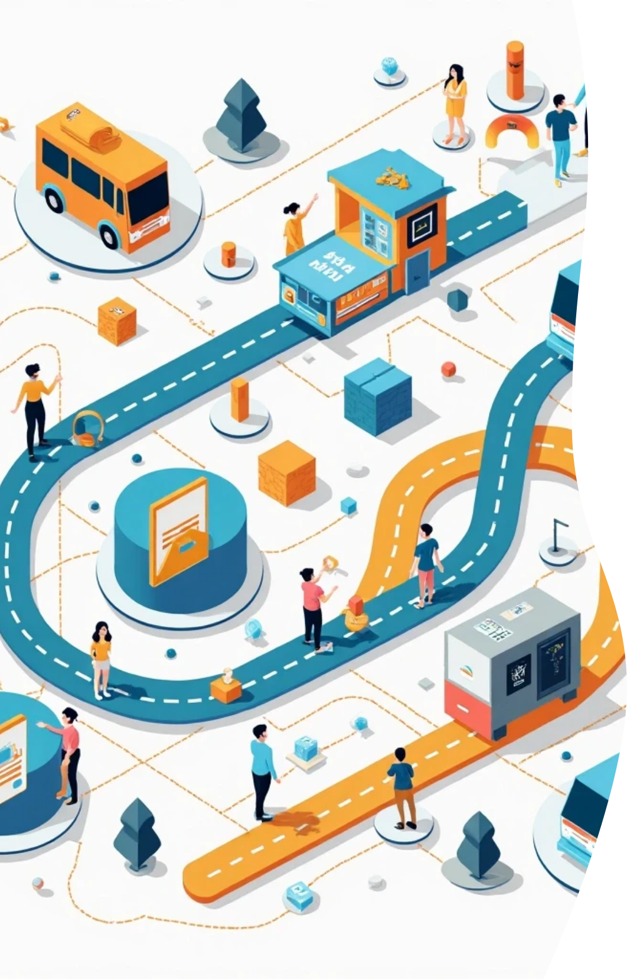
Bus Reservation system steps
1. User searches for buses by entering the source,
destination and travel date.
2. The system shows available buses with details like timing
fare, and seats.
3. The user selects a bus and chooses a seat.
4. The user enters personal details needed for booking.
5. Payment is made to confirm the booking.
6. The system saves the booking in the database.
7. A confirmation message with ticket details is shown
to the user.

Slide 9




Challenges Faced in Booking System
Handling Concurrent Bookings
Ensuring Data Security
User Authentication Issues

Slide 10

Why Our Website is Better than Others
Local Focus & Personalization – Designed for specific routes and regions with accurate timings, fares, and offers for
frequent travelers, students, and locals.
Simpler, Cleaner, Faster – No ads or popups, loads quickly even on slow internet for rural accessibility.
Transparent Pricing – No hidden charges, with a clear fare, tax, and discount breakdown before payment.
Extra Services Redbus Doesn’t Offer – Real-time bus tracking, digital passbook & ID card,and trip feedback system.
Better Customer Support – 24/7 local helpline with real people and faster issue resolution.
Secure & Flexible Payments – Multiple payment options including UPI.
Special Features for Operators – Easy bus, route, and seat management with automated sales and passenger reports.

Slide 11




Conclusion of the Project
Importance of Systems
2
How BusBuddies enhance travel efficiency.
Project Summary
1
A brief overview of the project's goals and outcomes.
Future Prospects
3
Potential improvements to enhance user experience.

Slide 12

Acknowledgments
Guided by
Contributions from
Support from
Bhavik Sir
Team members
Peers and mentors

Slide 13
Thank You!
We extend our heartfelt gratitude to everyone who contributed to this journey. Special thanks to Bhavik Sir for your guidance and to our team members, peers, and mentors for their unwavering support. Your encouragement and teamwork made this success possible.

